Slide 1


Sustainable & No Contact Attendance System Using ML
Submitted By:
Priyansu Sahoo – 1901227306(CSIT)
Abhishek Parasar – 1901227257(CSIT)
Partho Panigrahy – 1901227300(CSIT)
Alok Raj – 1901227263(CSIT)
Guided By:
Mr. Manas R Mishra
Assistant Professor

Slide 2
Outlines
Introduction
Literature survey
Problem Statement
Ideation
Problem Formulation & Representation
Conclusion

Slide 3
Introduction
Traditional method of attendance marking is a tedious task in many schools and colleges.
Which is also time consuming.
And prone to human errors.
This Project uses Face Recognition approach as it’s among the most productive image processing applications.
Face Recognition approach is only possible With the advancement of the deep learning technology.

Slide 4
Literature Survey
S.No | Author | Title | Methodology | Strength | Weakness
1. | Prajakta Lad, Sonali More, Simran Parkhe, Priyanka Nikam, Dipalee Chaudhari | Student Attendance System Using Iris Detection | In this system the student is requested to stand in front of the camera to detect and recognize the iris for the system to mark attendance for the student. Some algorithms like Gray Scale Conversion, Six Segment Rectangular Filter, Skin Pixel Detection is being used to detect the iris. | It helps in preventing the proxy issues and it maintains the attendance of the student. | It is one of the time consuming process for a student or the staff to wait until a student is done with the process.

Slide 5
Literature Survey..
S.No | Author | Title | Methodology | Strength | Weakness
2. | Yohei KAWAGUCHI, Tetsuo SHOJI, Wearne LIN, Koh KAKUSHO, Michihiko MINOH | Automated Attendance System Using Face Recognition | This system is based on face detection and recognition algorithms, which is used to automatically detects the student face when he/she enters the class. Some algorithms like Viola-Jones Algorithm cascade classifier and PCA algorithm for feature selection and SVM for classification. | It is less time consuming. It monitors student activity. | System have to store code of too many specific point of the human face.

Slide 6
Problem Statement
Aim of the Project:
Sustainable and No Contact Attendance system using Image processing & Machine learning Algo.
Scope of the project:
The scope of the project is the system on which the software is installed, i.e. the project is developed as a desktop application, and it will work for a particular institute. But later on the project can be modified to operate online.

Slide 7
Ideation
The idea is to track the students during a online class and keeps track of active period in a class. And to document the time a student enters the class and the time they take off.
And monitor all the activity during a online class. And reduce malpractice.

Slide 8
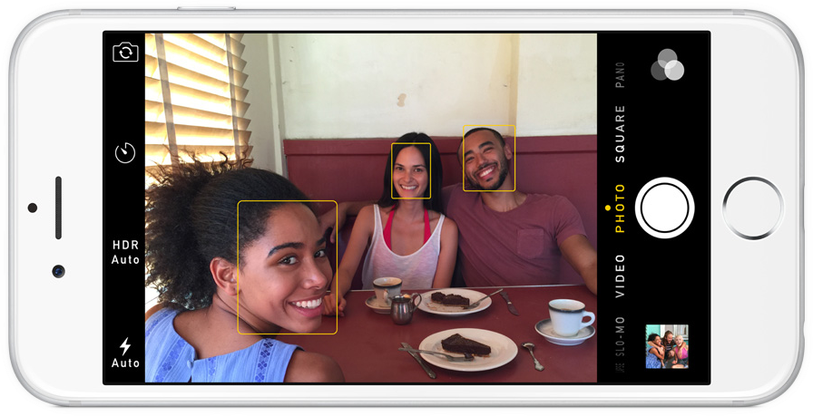
Problem Formulation & Representation
Step 1: Finding all the Faces
The first step in our pipeline is face detection. Obviously we need to locate the faces in a photograph before we can try to tell them apart!
If you’ve used any camera in the last 10 years, you’ve probably seen face detection in action.

Slide 9
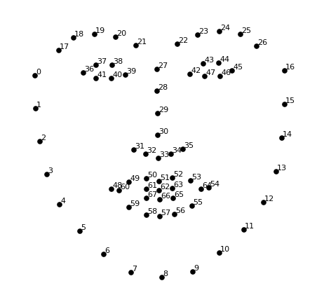
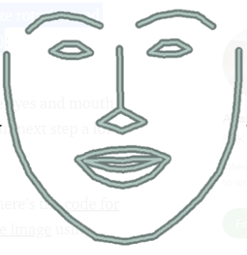
Step 2: Posing and Projecting Faces
Now that we have isolated the faces in our image. But now we have to deal with the problem that faces turned different directions look totally different to a computer.
To do this, we are going to use an algorithm called face landmark estimation.
The basic idea is we will come up with 68 specific points (called landmarks) that exist on every face — the top of the chin, the outside edge of each eye, the inner edge of each eyebrow, etc. Then we will train a machine learning algorithm to be able to find these 68 specific points on any face.
We are only going to use basic image transformations like rotation and scale that preserve parallel lines called affine transformation.

Slide 10
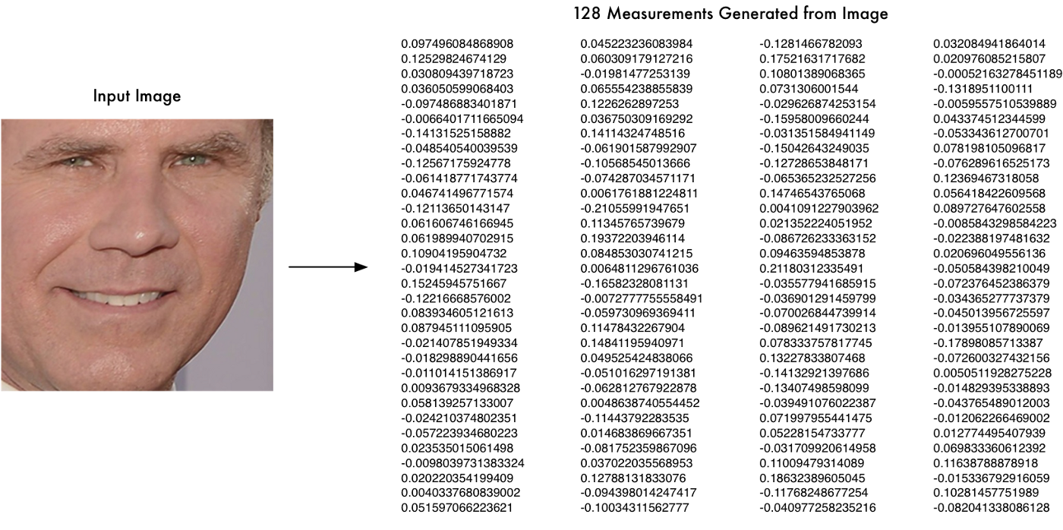
Step 3: Encoding Faces
In Step 2 with all the pictures we have of people that have already been tagged. When we find a previously tagged face that looks very similar to our unknown face, it must be the same person.
There’s actually a huge problem with that approach. That would take way too long. They need to be able to recognize faces in milliseconds, not hours.
To solve this problem we are going to train it to generate 128 measurements for each face and store it in a database. After which it is easy for the machine to execute and compare faces with this data.

Slide 11
Step 4: Finding the person’s name from the encoding
All we have to do is find the person in our database of known people who has the closest measurements to our test image.
We can do that by using any basic machine learning classification algorithm.

Slide 12
Step 5: Monitoring Activity
We can monitor the video and detect whether the student is currently available in the video frame or not.
If the condition is normal i.e. if the student is present in the video frame for more than or equal to 70% of the class time, then he/she will get the attendance. And vice-versa for abnormal.

Slide 13
Test picture of another person(y)
(128 measurements )
Picture of a person(x)
(128 measurements generated)
Another picture of (y)
(128 measurements generated)
Compare results
Tweak neural net slightly so that the measurements for the two (y) pictures are closer and the (x) measurements are further away.

Slide 14
Road Map
Feb-March month:
We have build a face detection system which stores attendance in an excel sheet, when a previously tagged face is detected.
April:
Integrating MySQL Database.
July-Oct month:
Optimizing the system. So that this feature can be used in real-life conference call.

Slide 15
Reference:
Prajakta Lad, Sonali More, Simran Parkhe, Priyanka Nikam, Dipalee Chaudhari, " Student Attendance System Using Iris Detection", IJARIIE-ISSN(O)-2395-4396, Vol-3 Issue-2 2017.
Akshara Jadhav, Akshay Jadhav, Tushar Ladhe, Krishna Yeolekar, "Automated Attendance System Using Face Recognition", International Research Journal of Engineering and Technology (IRJET), Volume 4, Issue 1, Jan 2017.
N.Sudhakar Reddy, M.V.Sumanth, S.Suresh Babu, "A Counterpart Approach to Attendance and Feedback System using Machine Learning Techniques",Journal of Emerging Technologies and Innovative Research (JETIR), Volume 5, Issue 12, Dec 2018.
Dan Wang, Rong Fu, Zuying Luo, "Classroom Attendance Auto-management Based on Deep Learning",Advances in Social Science, Education and Humanities Research, volume 123,ICESAME 2017.
B Prabhavathi, V Tanuja, V Madhu Viswanatham and M Rajashekhara Babu, "A smart technique for attendance system to recognize faces through parallelism", IOP Conf. Series: Materials Science and Engineering 263, 2017.

Slide 16
Reference …..
Samuel Lukas, Aditya Rama Mitra, Ririn Ikana Desanti, Dion Krisnadi, "Student Attendance System in Classroom Using Face Recognition Technique", Conference Paper DOI: 10.1109/ICTC.2016.7763360, Oct 2016.
K.Senthamil Selvi, P.Chitrakala, A.Antony Jenitha, "Face Recognition Based Attendance Marking System", IJCSMC, Vol. 3, Issue. 2, February 2014.
Yohei KAWAGUCHI, Tetsuo SHOJI, Weijane LIN, Koh KAKUSHO, Michihiko MINOH, "Face Recognition-based Lecture Attendance System", Oct 2014.
Shireesha Chintalapati, M.V. Raghunadh, "Automated Attendance Management System Based On Face Recognition Algorithms", IEEE International Conference on Computational Intelligence and Computing Research, 2013.
B. K. Mohamed and C. Raghu, “Fingerprint attendance system for classroom needs,” India Conference (INDICON), Annual IEEE, pp. 433–438, 2012.

Slide 17
Thank You

